Slide 1

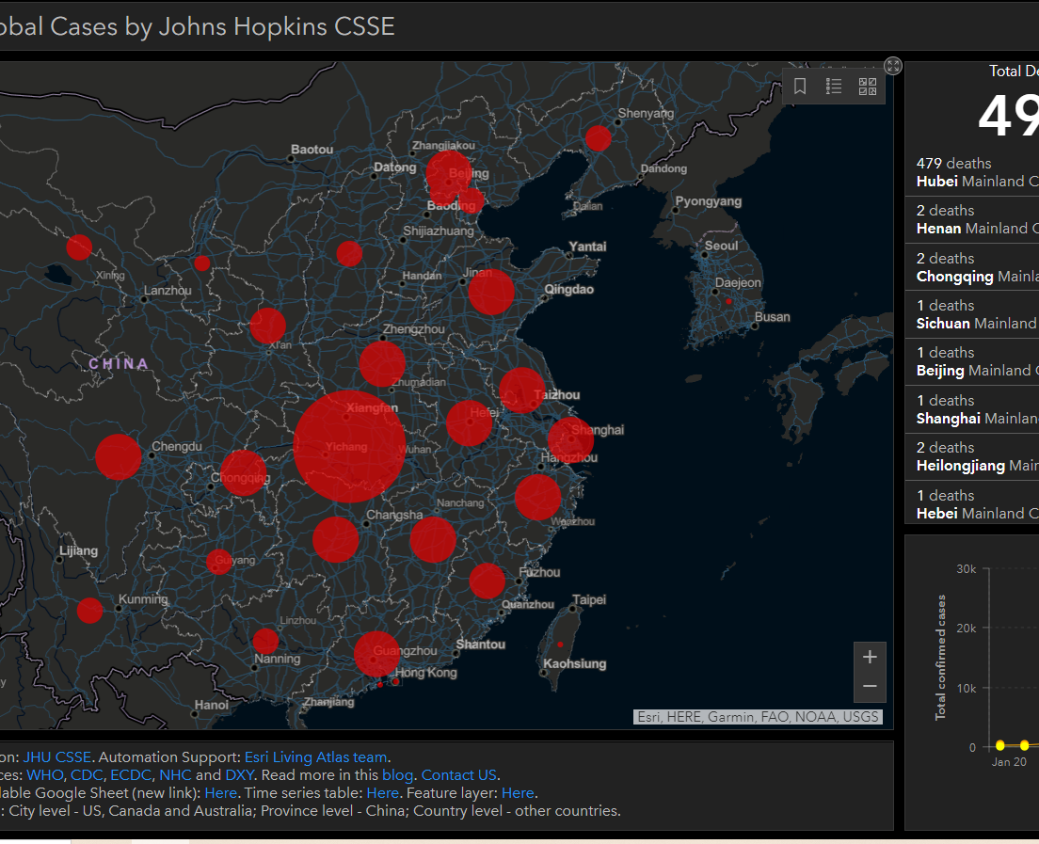
Applying AI for Coronavirus Real Time Heat Map
Analyze and Filter the information upon the reaction
Created by:
Rami MOUBAYED - rmoubayed12@gmail.com
Thanh Tung TRINH – tungtrinhthanh@hotmail.com
Anh Tu NGUYEN - tunguyen.hust@gmail.com

Slide 2

What is the most scary thing about the Outbreak of Corona Virus?

Slide 3
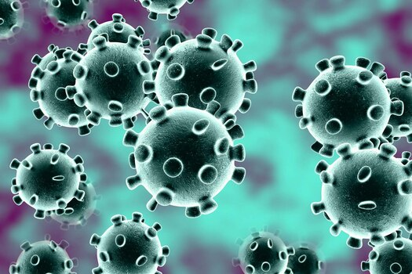
Fact about SARS Vs Corona Virus
The Coronavirus is recently becoming a world emergency while it is spreading around the world.
Thanks to modern technology and Artificial Intelligence, there are existing works that try to identify the number of infected individuals in the entire world.
Data scraping tools are used to extract these information. The data are being scrapped from all over the internet.
Any footprint found related to the virus is extracted and analyzed to inform scientists about the situation in real-time using data visualization tools.
At the time in 2003, there were no ways to rapidly identify key information to resist SARS, which is also a type of Coronavirus. And today, there are more than 24 thousand confirmed cases though less are dying from it thanks to the rapidity in spreading information.

Slide 4

The information we need the most
another information, scientists want to find the source of the disease
keywords can be: source, origin, appearance.
scientists are looking for: genetic sequence
they say many researchers have launched them in public.
it is a good information so that researchers can collect all the samples and analyze them
another information, peers are looking for information about the cure or any kind of medicine that can resist the virus.

Slide 5
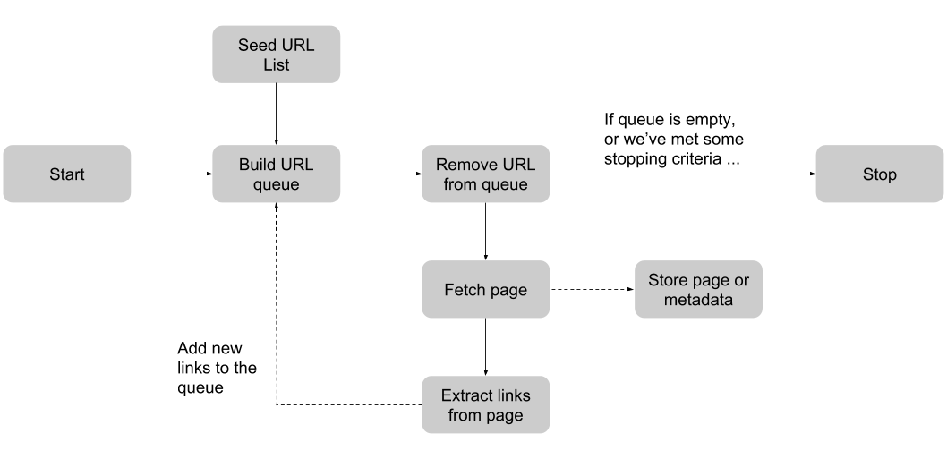
Data Flow
2 Levels

Slide 6
Activities Diagram
Scrabing
Identifying
Cleaning

Slide 7
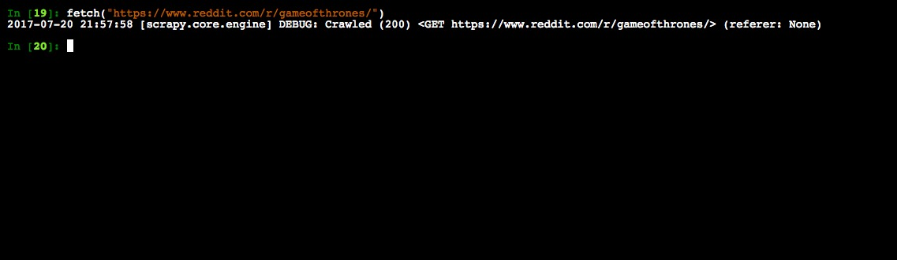
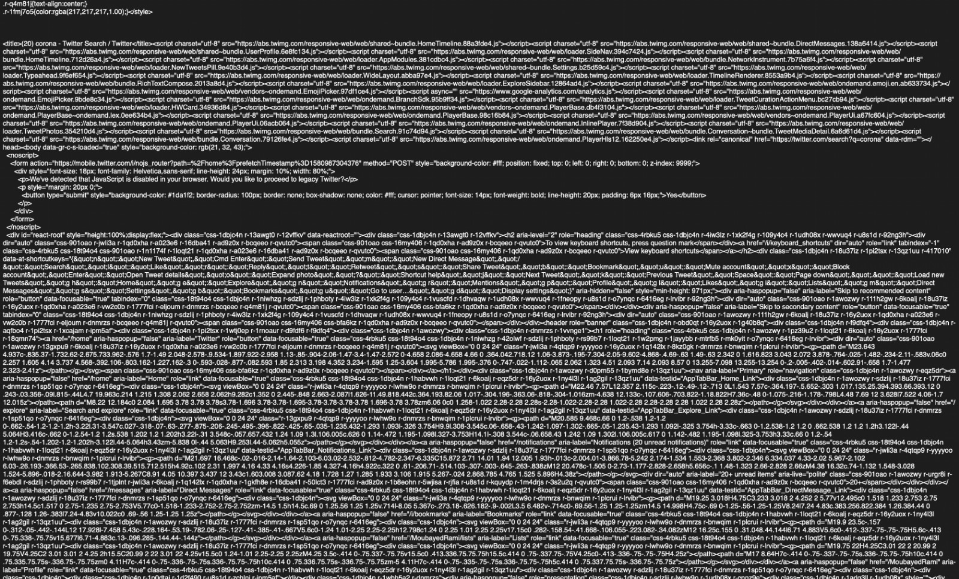
Web Scraping using Scrapy

Slide 8
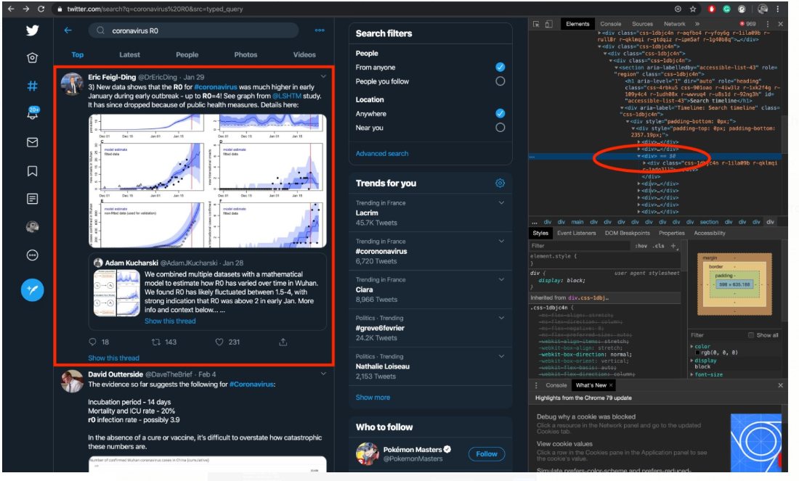
Right Information from Scraping

Slide 9
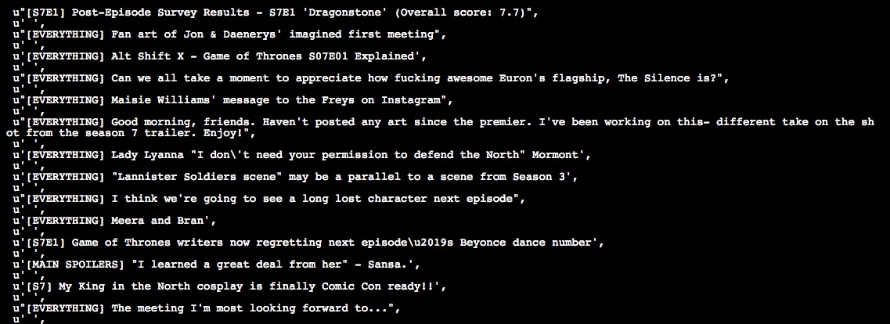
Data Cleaning using Scrapy
response("div::attr(<div class="css-1dbjc4n r-1ila09b ...).extract()

Slide 10
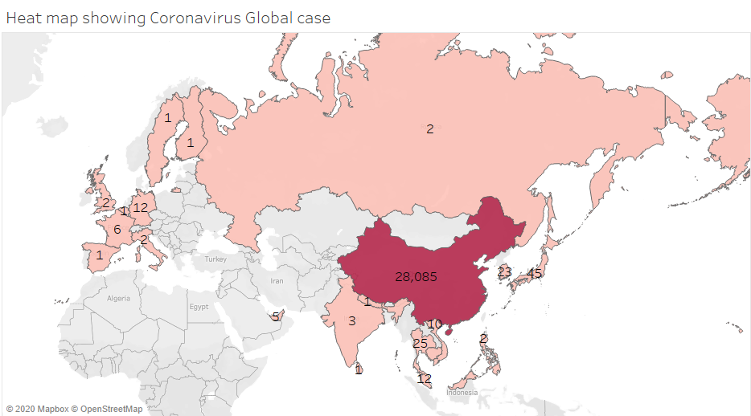
Demonstration – Heat Map

Slide 11
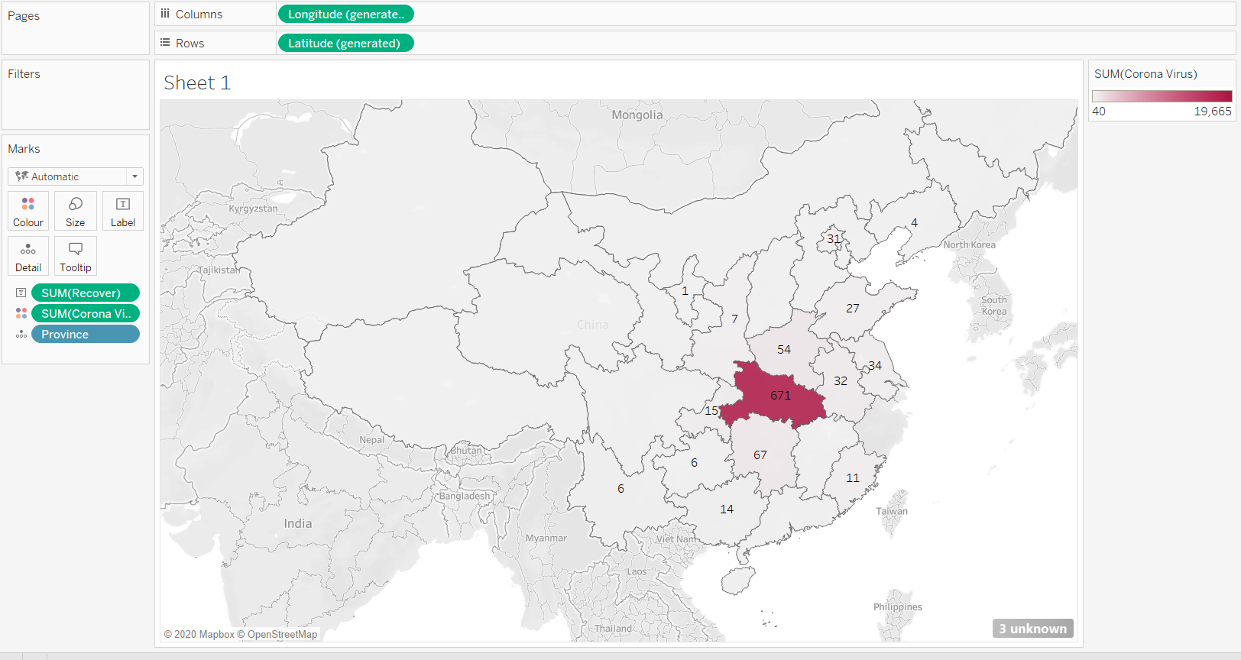
Demonstration – Details Heat Map by Country

Slide 12

The benefits of the Project, we can have
The right information
At Right Time
And Right Place

Slide 13

Thank you!

